Slide 1

IoT-Based BigData Analysis for Sensor Data
PRESENTED BY
Prateek Manoj Mhatre Mustafa Haji
Krish Didwania
Arihant Singhvi
Shreya Prakash Ghatage

Slide 2

Table of
CONTENTS
01
02
03
04
05
Objectives
Introduction
Motivation
Background Theory &
Framework Overview
Components
06
07
08
09
10
Methodologies and Approach
Experiments & Results
Applications
Future Work
Conclusion

Slide 3

Objective 1
Develop a robust framework for real-time data streaming and processing of sensor data from IoT devices.
Objective 2
OBJECTIVES
Integrate Apache Kafka, Hadoop, and Apache Spark to efficiently handle high-volume, high-velocity, and high-variety data streams.
Objective 3
Utilize Inertial Measurement Unit (IMU) sensors for capturing critical motion data and analyze it for practical applications.
Objective 4
Provide actionable insights and visualization tools to enhance decision-making across various sectors like industrial automation and smart cities.

Slide 4
INTRODUCTION
Context:
The integration of IoT and big data analytics has emerged as a pivotal area in technology, enhancing capabilities across various domains.
Importance of Big Data in IoT:
IoT devices generate vast amounts of data, requiring advanced techniques for efficient processing and insightful analysis.
Key Technologies:
Apache Kafka for real-time data ingestion.
Hadoop for distributed storage.
Apache Spark for real-time and batch processing analytics.
Focus of the Study:
This report investigates the design and implementation of an IoT-based big data analytics framework utilizing IMU sensors.

Slide 5

1. Unprecedented Data Growth:
The rise of IoT devices leads to massive data generation, making effective data analysis essential for innovation.
2. Demand for Real-Time Insights:
In industries such as healthcare and transportation, immediate data analysis can drive critical decision-making.
3. Diverse Applications:
Different sectors require customized analytics solutions that can handle various data types and operational needs.
4. Enhancing Security:
With increased connectivity, advanced analytics can improve security measures against cyber threats.
5. Fostering Sustainable Practices:
Effective data analysis can optimize resources, contributing to environmentally sustainable operations.
Motivation

Slide 6

Background Theory and Framework Overview
01
Big Data Characteristics:
Volume: Massive amounts of data generated from IoT devices.
Velocity: Speed at which data is generated and processed.
Variety: Different data formats and sources requiring flexible analysis.
02
IoT Ecosystem:
A network of interconnected devices communicating and exchanging data for enhanced functionality and automation.
03
Framework Overview:
Integrates data collection, streaming, processing, and visualization for comprehensive insights.
Key components include Apache Kafka, Hadoop, and Apache Spark.

Slide 7
COMPONENETS
APACHE KAFKA:
HADOOP:
APACHE SPARK:
INERTIAL MEASUREMENT
UNITS(IMU):
A distributed messaging system designed for real-time data streaming, ensuring efficient data ingestion.
A framework for distributed storage and processing of large datasets, utilizing the Hadoop Distributed File System (HDFS).
An analytics engine for big data processing, providing real-time and batch processing capabilities with in-memory computation.
Sensors that provide motion data, crucial for applications in robotics, wearable technology, and smart infrastructure.

Slide 8

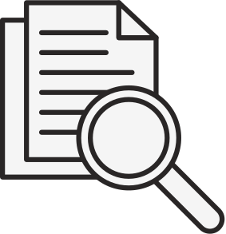

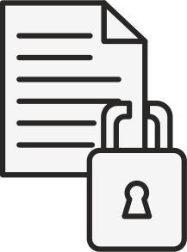
METHODOLOGIES AND APPROACH
1. Data Collection and Preprocessing
Sensor Integration:
IMUs, gas sensors, and temperature sensors are connected to a Raspberry Pi for real-time data acquisition.
Sensor data includes motion (acceleration, orientation), environmental (gas concentration, temperature), and more.
Preprocessing on the Edge:
Initial cleaning and normalization are performed directly on the Raspberry Pi, reducing noise and ensuring consistent data formats before streaming.
Edge computing filters irrelevant data, minimizing bandwidth consumption and improving the data quality.
2. Data Streaming and Ingestion
Apache Kafka:
Used for real-time data streaming, enabling continuous transmission of sensor data to the cloud infrastructure.
Kafka’s publish-subscribe model ensures that data from multiple sensors is ingested into the system efficiently and reliably.
Partitioning and Scaling:
Data is divided into partitions based on sensor type and geographical location, ensuring scalability and fault tolerance.
Streams are processed in parallel for improved performance and reduced latency.
3. Processing and Analytics
Batch and Real-Time Processing:
Hadoop is employed for batch processing of historical sensor data, enabling large-scale analytics and pattern discovery.
Apache Spark Streaming provides real-time processing for immediate insights and anomaly detection..
Visualisation:
Data is visualised in real-time using Tkinter, offering dynamic, interactive dashboards that track key metrics such as acceleration patterns, temperature changes, and environmental conditions.

Slide 9
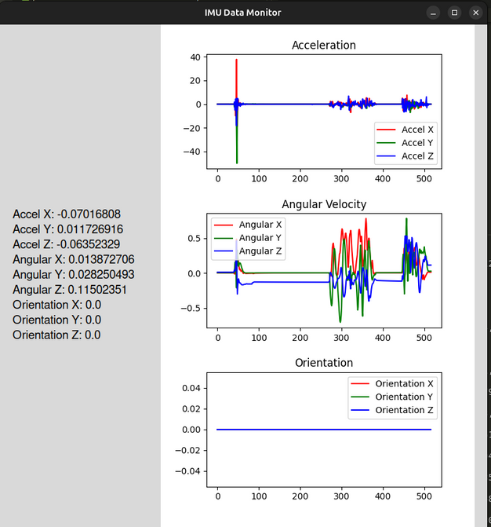
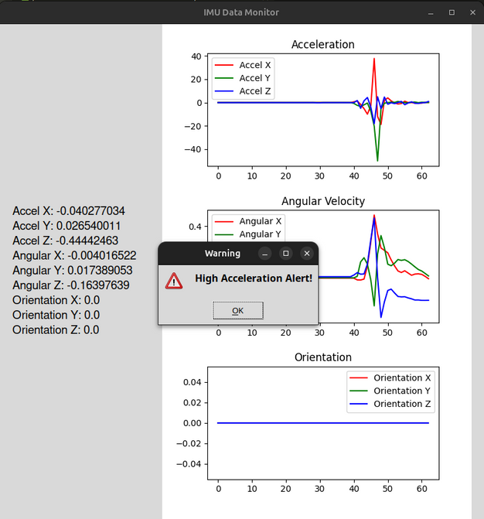
EXPERIMENTS & RESULTS
Fig. 1 : GUI Displaying Motion Data
with Dynamic Graphs
Experiment Overview:
Utilized IMUs to capture motion data, focusing on linear acceleration, angular velocity, and orientation.
Data Storage:
Collected sensor data is stored in HDFS for scalable access and processing.
Key Findings:
Distinct patterns observed in linear acceleration during various activities (e.g., walking, running).
Angular velocity data provided insights into rotational movements and device orientation changes.
Visualization Outcomes:
Dynamic graphs in Tkinter demonstrated real-time trends, allowing for detailed analysis of movement patterns.
Fig. 2 : GUI Displaying Warning
Messaage

Slide 10
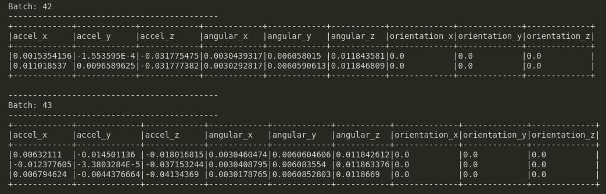
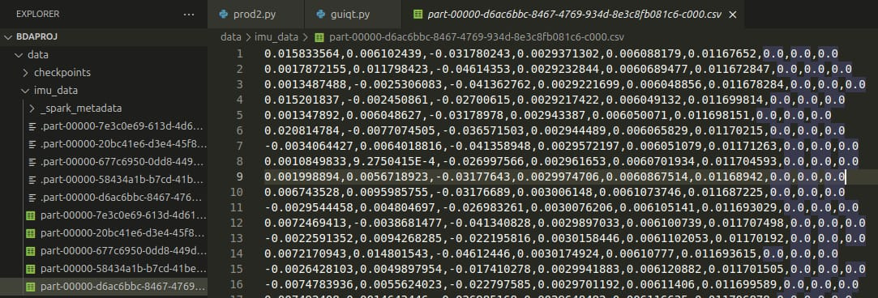
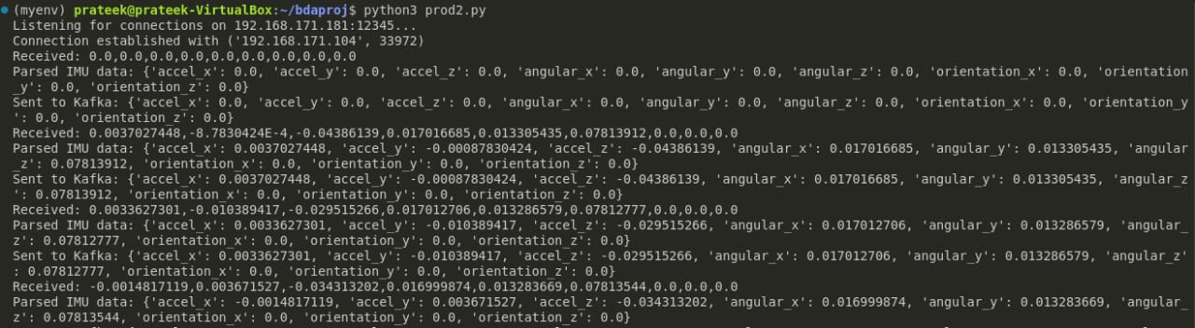
Fig. 3 : Receiving data from IMU sensor batch wise
Fig. 4 : Producer sending values
Fig. 5 : Consumer receiving values

Slide 11

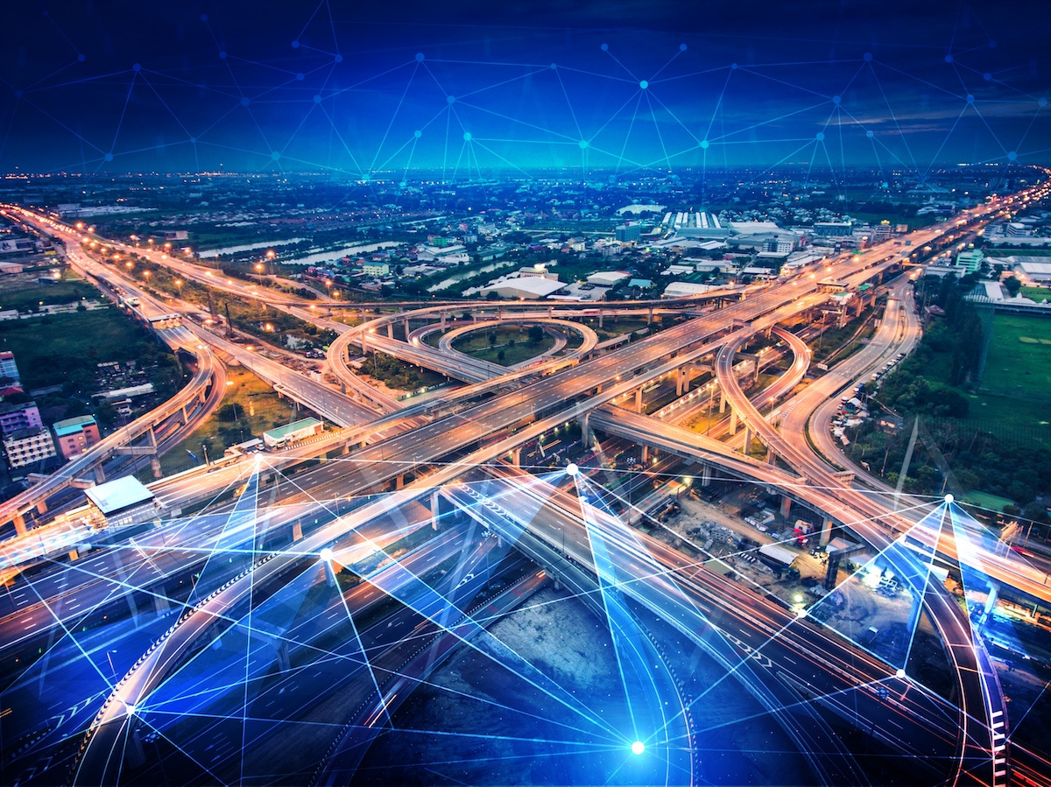
APPLICATIONS
Smart Cities:
IMU data assists in traffic monitoring and infrastructure health assessments.
Industrial Automation:
Real-time analytics enable predictive maintenance, reducing downtime and costs.
Healthcare:
Wearable devices utilize IMUs for health monitoring, posture correction, and activity tracking.
Autonomous Vehicles:
Navigation systems leverage IMU data for improved safety and performance in transportation.

Slide 12
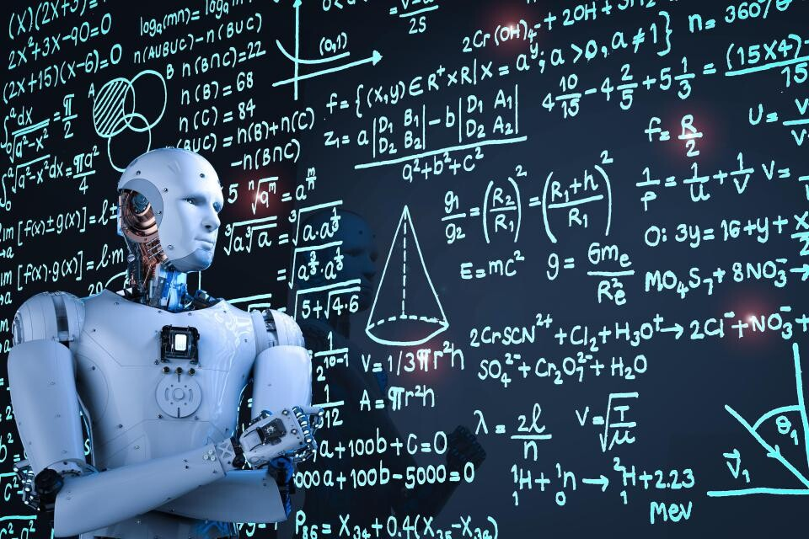
FUTURE WORK
Scalability Enhancements:
Explore the addition of more sensors and processing nodes to accommodate increasing data volumes.
Advanced Machine Learning Models:
Investigate the application of deep learning techniques for enhanced predictive analytics.
Expanded Applications:
Broaden the scope of applications to include smart agriculture and environmental monitoring.
User-Centric Visualizations:
Develop more interactive and customizable dashboards for different user requirements.

Slide 13
CONCLUSION
Summary:
The proposed IoT-based big data analytics framework effectively integrates Kafka, Hadoop, and Spark, addressing the challenges of high-volume data processing.
Impact:
This framework demonstrates the significant potential of leveraging IoT-generated data for actionable insights across multiple domains.
Call to Action:
Encourage further exploration and innovation in the field of IoT analytics to unlock even more opportunities for efficiency and sustainability.

